Slide 1

AI: Vehicle detection with Computer Vision
BOUHADDI Zakariya
DIDOUH Mohamed
ISHIMWE Blaise

Slide 2


Introduction
Computer Vision : what is it?
Projects for vehicle detection
Based on image processing with counting
Traffic flow analysis
Based on classification (SVM)
Autonomous cars
https://www.learnopencv.com/install-opencv-3-and-dlib-on-windows-python-only/

Slide 3
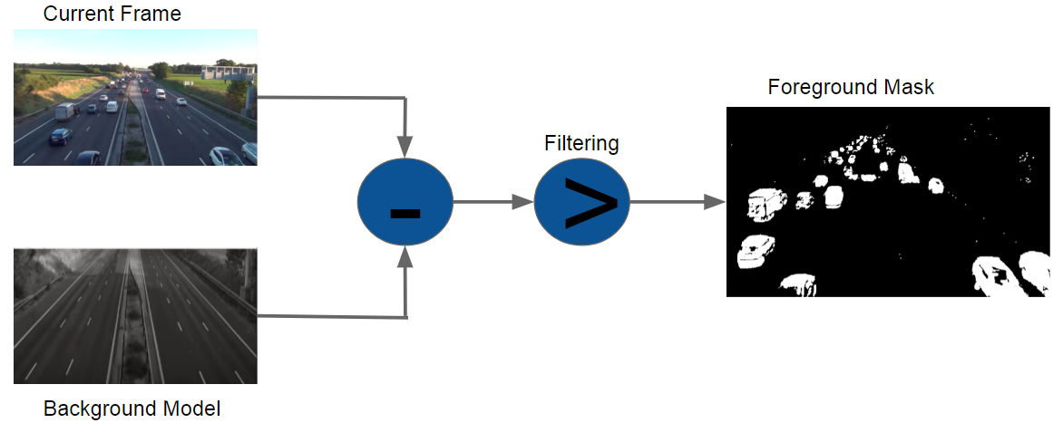
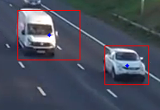
Project 1
Background subtraction algorithm
Filtering
Object detection by contours
Counting

Slide 4
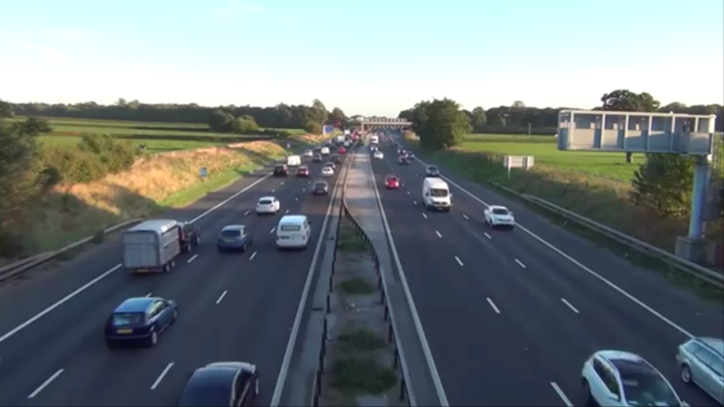
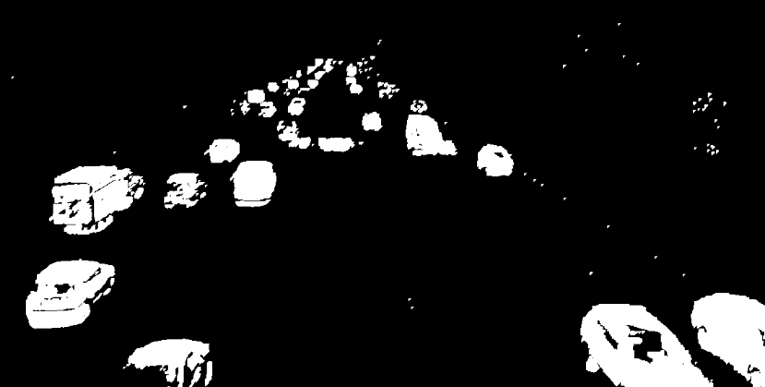
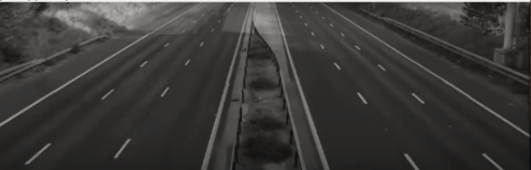
Background Subtraction Algorithm
Current Frame
Foreground Mask
Filtering
-
>
Background Model

Slide 5





Filtering based on OpenCV operations
Closing - Filling the small holes in the image object
Opening - Removing the noise from the image
Dilation - Making the image object stand out
Erosion
Dilation
Erosion
Dilation
Dilation
https://docs.opencv.org/3.1.0/d9/d61/tutorial_py_morphological_ops.html

Slide 6
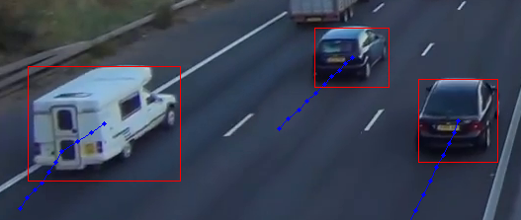
Objects Detection by contours
Using Standard functions cv2.findContours(), cv2.drawContours()
Finding external contours
Filtering by height and width
Getting center of the bounding box (vehicle)

Slide 7
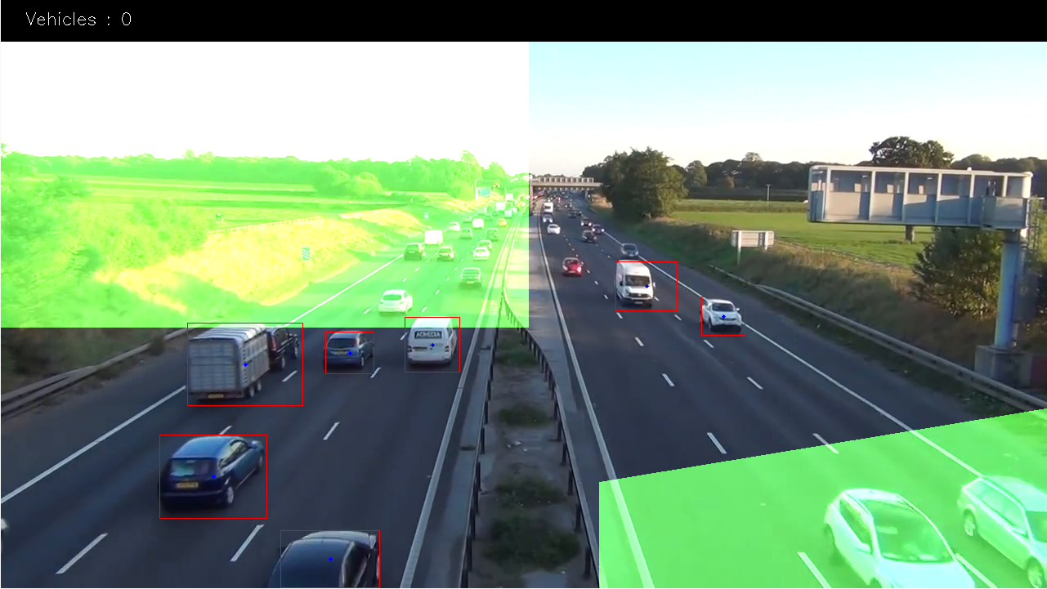
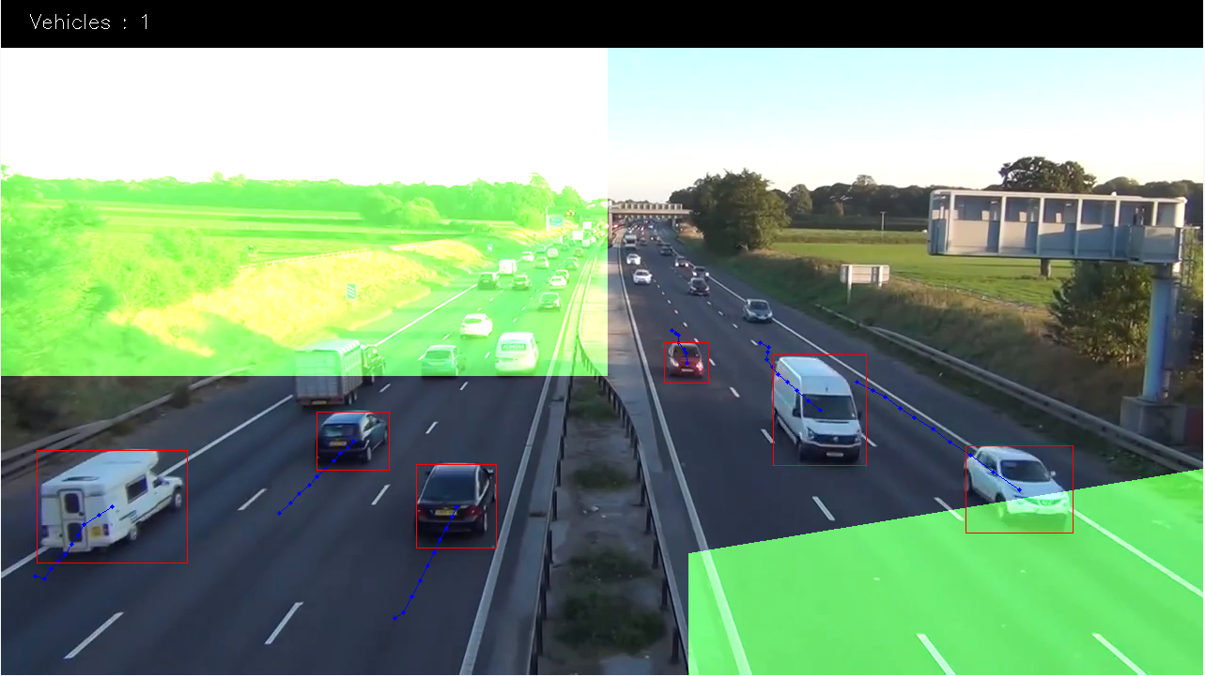
Counting
Vehicle passed entirely the zone

Slide 8


Project 2
Classifying cars
Finding cars on images or videos
Class A
Classifier
Class B

Slide 9
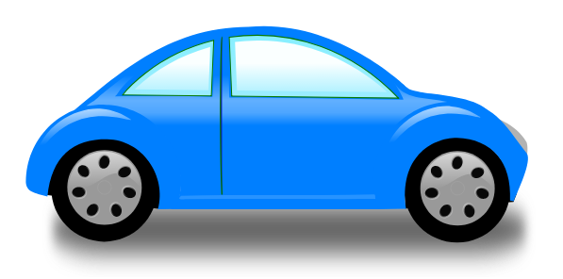
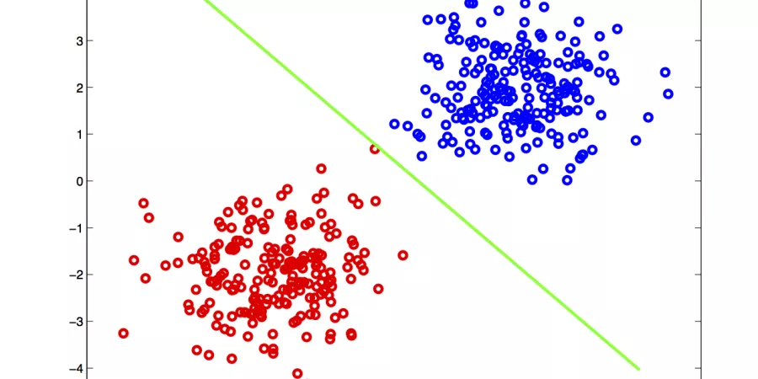

Classifying cars
What is classified?
Vehicles
Non-Vehicles
Creating the dataset
Classifier
Extracting features from the dataset
Histogram of Oriented Gradient
Histogram of Colors (RGB, YCrCb, LUV …)
Normalizing and combining features
Training the classifier
http://www.everythingai.co.in/2018/02/15/logistic-regression/

Slide 10
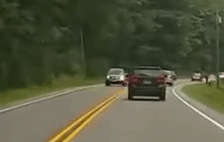

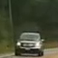
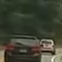
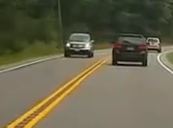
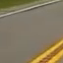
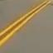

Creating the dataset
Create from video:
Frames folder
Tiles folder
Sorting in folders:
Removing irrelevant images
Separating between vehicles and non-vehicles
Vehicles
Non-Vehicles

Slide 11
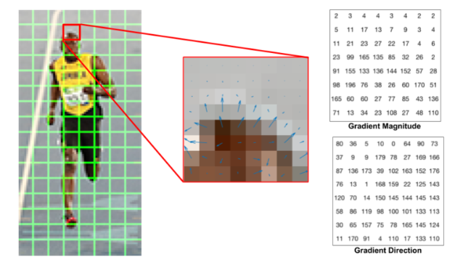
Extracting the features
HOG (Histogram of Oriented Gradient)
https://www.learnopencv.com/wp-content/uploads/2016/12/hog-cell-gradients.png

Slide 12
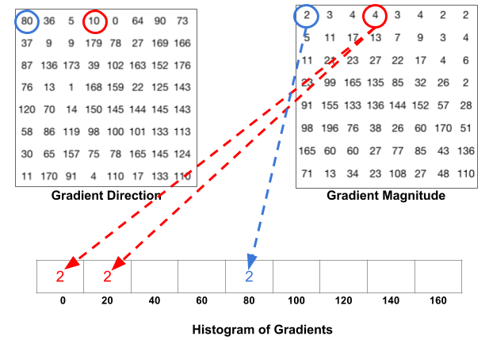
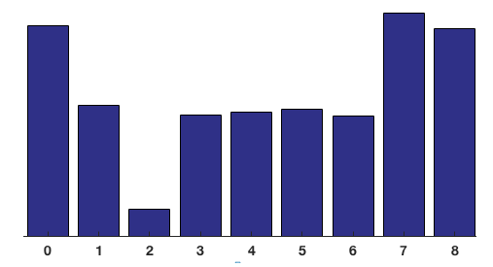
Extracting the features (2)
https://www.learnopencv.com/wp-content/uploads/2016/12/hog-histogram-1.png
https://www.learnopencv.com/wp-content/uploads/2016/12/histogram-8x8-cell.png

Slide 13
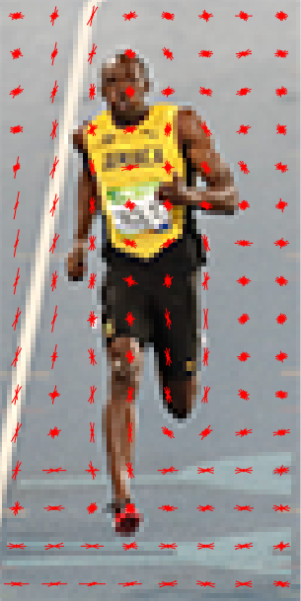
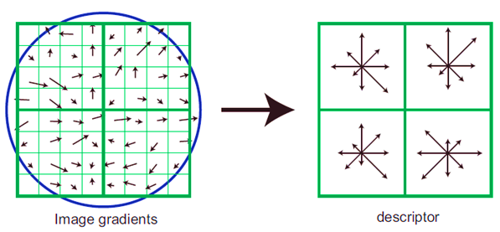
Extracting the features (2’)
http://farshbafdoustar.blogspot.com/2011/09/hog-with-matlab-implementation.html
https://www.learnopencv.com/wp-content/uploads/2016/12/hog-visualization.png

Slide 14
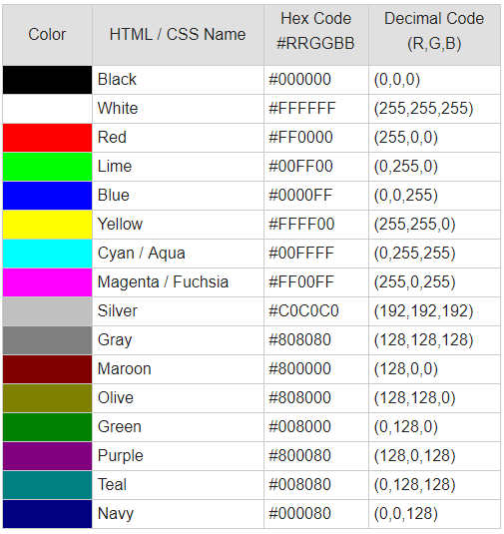
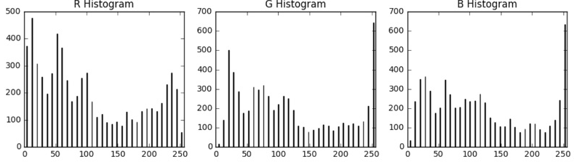
Extracting the features (3)
Extracting the histogram of color features
Normalizing and combining the features
http://www.coldvision.io/wp-content/uploads/2017/03/rgb-histogram-plot.jpg
https://www.rapidtables.com/web/color/RGB_Color.html

Slide 15
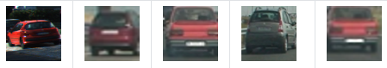

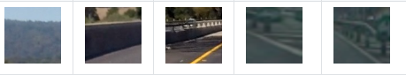
Training the classifier
Sklearn Library
Data sets
80% for training
20% for testing
LinearSVC()
Parameters
Vehicle
Non-Vehicle
https://docs.opencv.org/2.4/doc/tutorials/ml/introduction_to_svm/introduction_to_svm.html

Slide 16
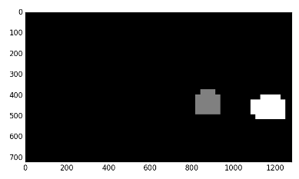
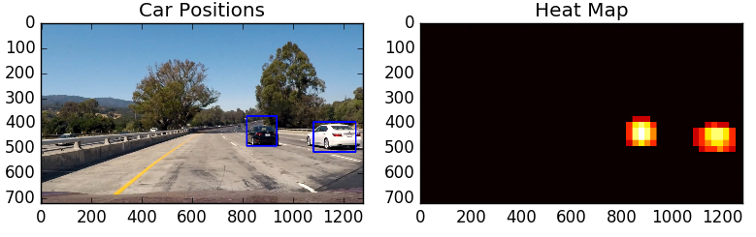
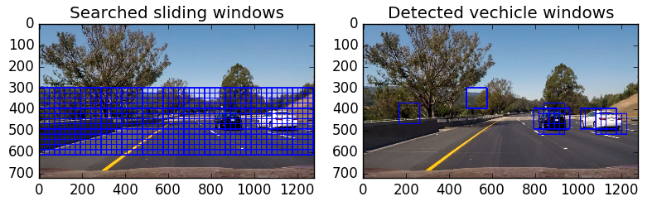
Finding cars on images or videos
Searching with the Sliding Window
Generating the heatmap
Finding the cars
https://towardsdatascience.com/vehicles-tracking-with-hog-and-linear-svm-c9f27eaf521a

Slide 17
Demonstrations
Project 1 :
Input video
Output video

Slide 18
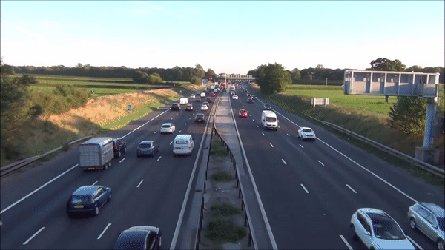
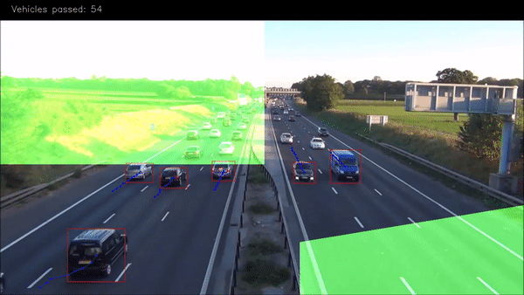
Demonstrations (1)
Input video
Output video

Slide 19
Demonstrations (2)
Project 2 :
Original project
Videos without training
Videos with training

Slide 20
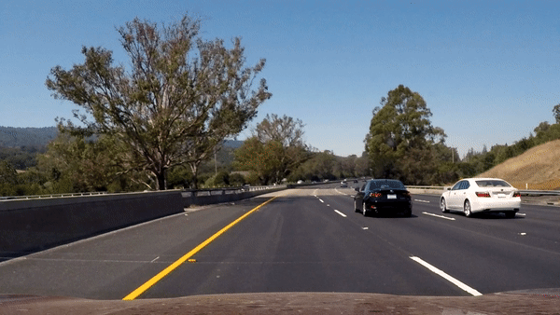
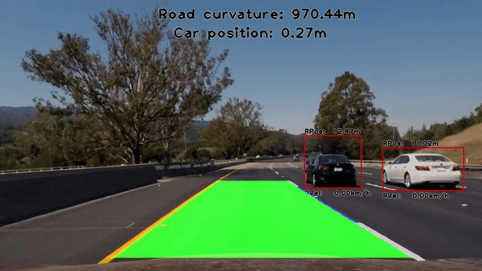
Demonstrations (3)
Input video
Output video

Slide 21
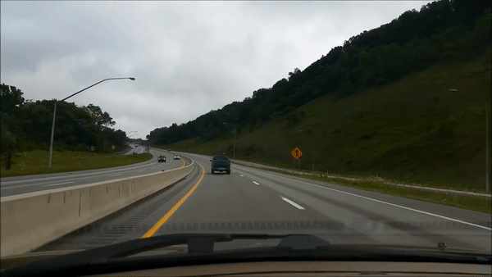
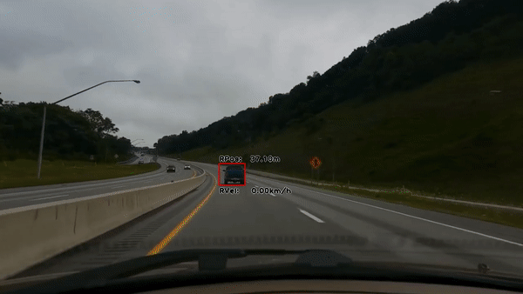

Demonstrations (4)
Trained with default dataset
Trained with our dataset

Slide 22
Bibliography
Sklearn library documentation: https://rebrand.ly/sklearn
Classification of Fruits Using Computer Vision and a Multiclass Support Vector Machine: https://rebrand.ly/SVM
Fish species classification by color, texture and multi-class support vector machine using computer vision: https://rebrand.ly/SVM2
Project repository: https://rebrand.ly/ProjectRepo
Vehicle Detection And Counting In Traffic Video Based On Opencv: https://rebrand.ly/VehicleDetect
Vision based real time traffic monitoring: https://rebrand.ly/TrafficMonitoring
Computer Vision Based Vehicle Detection for Toll Collection System Using Embedded Linux: https://rebrand.ly/CompVision
Traffic Surveillance Camera Calibration by 3D Model Bounding Box Alignment for Accurate Vehicle Speed Measurement: https://rebrand.ly/CamCalib3D

Slide 23
Credits
https://www.learnopencv.com/install-opencv-3-and-dlib-on-windows-python-only/
https://docs.opencv.org/3.1.0/d9/d61/tutorial_py_morphological_ops.html
https://docs.opencv.org/2.4/doc/tutorials/ml/introduction_to_svm/introduction_to_svm.html
https://www.learnopencv.com/histogram-of-oriented-gradients/
https://towardsdatascience.com/vehicles-tracking-with-hog-and-linear-svm-c9f27eaf521a
https://rebrand.ly/ProjectRepo
http://www.everythingai.co.in/2018/02/15/logistic-regression/
http://www.clker.com/cliparts/S/J/k/r/N/m/blue-car-md.png
http://farshbafdoustar.blogspot.com/2011/09/hog-with-matlab-implementation.html
https://www.rapidtables.com/web/color/RGB_Color.html

Slide 24
Project 2
Classifying cars
Finding cars on images or videos
Classifier

Slide 25
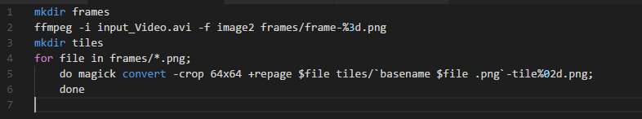
Creating the dataset
Tiles generation script:

Slide 26
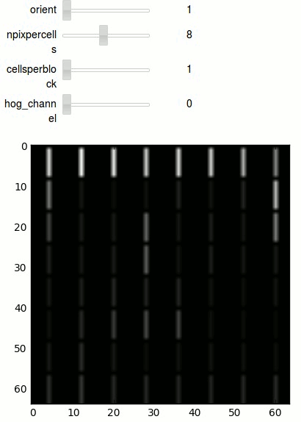
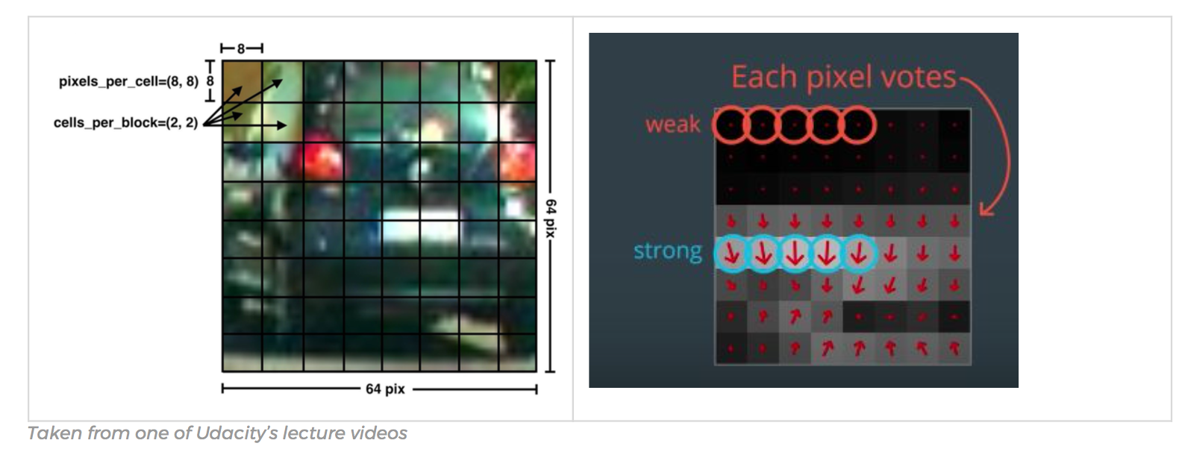
Extracting the features (3’)
https://towardsdatascience.com/vehicles-tracking-with-hog-and-linear-svm-c9f27eaf521a
https://chatbotslife.com/vehicle-detection-and-tracking-using-computer-vision-baea4df65906

Slide 27
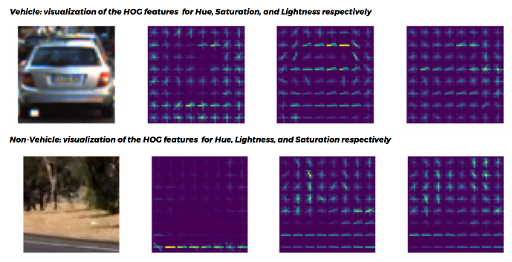
Results of features extraction
https://towardsdatascience.com/vehicles-tracking-with-hog-and-linear-svm-c9f27eaf521a

Slide 28
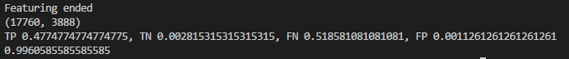
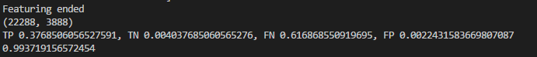
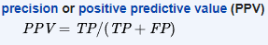
Training the classifier (Performance)
Original training results
Wrongly trained with irrelevant images
Trained without irrelevant images

Slide 29
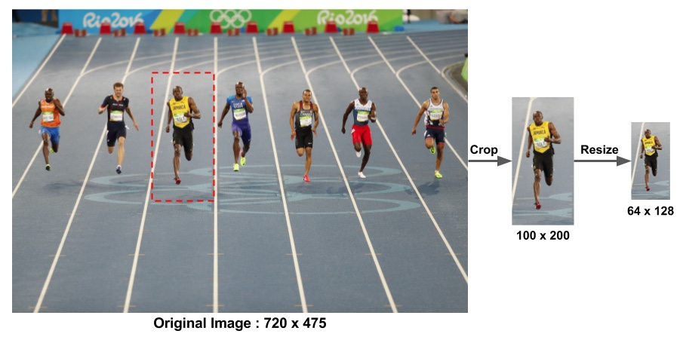
Improvements
https://www.learnopencv.com/wp-content/uploads/2016/11/hog-preprocessing.jpg

